Slide 1
Session ID: J0688
Watson OpenScale Overview and Hands-on Lab
Eric Martens, Digital Technical Enablement
Elena Lowery, WW Team, Data Science and AI
Owais Hashmi, NA Team, Data Science and AI

Slide 2
Check-in Code = c836 Access the check-in link at the bottom of the session details in the mobile app.

Slide 3
Legal Disclaimer
© IBM Corporation 2020. All Rights Reserved.
The information contained in this publication is provided for informational purposes only. While efforts were made to verify the completeness and accuracy of the information contained in this publication, it is provided AS IS without warranty of any kind, express or implied. In addition, this information is based on IBM’s current product plans and strategy, which are subject to change by IBM without notice. IBM shall not be responsible for any damages arising out of the use of, or otherwise related to, this publication or any other materials. Nothing contained in this publication is intended to, nor shall have the effect of, creating any warranties or representations from IBM or its suppliers or licensors, or altering the terms and conditions of the applicable license agreement governing the use of IBM software.
References in this presentation to IBM products, programs, or services do not imply that they will be available in all countries in which IBM operates. Product release dates and/or capabilities referenced in this presentation may change at any time at IBM’s sole discretion based on market opportunities or other factors, and are not intended to be a commitment to future product or feature availability in any way. Nothing contained in these materials is intended to, nor shall have the effect of, stating or implying that any activities undertaken by you will result in any specific sales, revenue growth or other results.

Slide 4
Agenda
Watson OpenScale
Overview
Demo best practices
Hands-on lab

Slide 5
Watson OpenScale

Slide 6






Data Science platform on Cloud Pak for Data
Organize and Govern data
Build
Deploy and run
Operate
trusted AI
Watson Knowledge
Catalog
Watson Studio
Watson Machine Learning
Watson OpenScale
Data Profiling
Data Exploration
Model Deployment
Business KPIs and production metrics
Quality and Lineage
Data Preparation
Model Management
Fairness & Explainability
Governance
Model Development
Retraining
Inputs for Continuous Evolution
Organize Data for AI
Build AI
Run AI
Operate AI
Data Scientist
App Developer
AI Ops
Data Engineer
Consume AI
Business user
Notes:
Our portfolio has 4 key pillars that can be mixed and matched with other solutions in the market pending on your need.
On the organizing and governing side, you have WKC
catalogs all your data into 1 place so you understand your data and know where it is
Also helps clients understand who is accessing the data and control permissions
The build phase is actually wanting to look into your data, prep it, and build some models or dashboards that can give you predictive insight into your data & this is where WS comes in.
This is the 1 data science platform where you can bring your data into the platform, process it, build models, do all kinds of visualizations, and then report that data to a dashboard or to management or to a different user → all of that is in WS
Once you have your models built, the next step is to deploy those models into production, and to use the output predictions to influence business decisions. & We make it very easy to move your models from development to production with WML.
So now you have governance, you’ve built your model, you’ve deployed it, and now you’re getting the predictions of whom you should give a loan to or who you should market to – but the natural next question is “Do you trust the output of the model? Do you trust its decision? How do you make sure the model isn’t biased by the person who built it?” And that’s exactly where WOS comes in.
WOS helps clients understand how the model is making decisions so the logic can be traced. You can see what features the model is giving you predictions off of
You can retrain your model based on key metrics that you specify.
So stepping back you can see that these solutions fulfill the whole end to end AI journey. It is very easy to deploy manage, and monitor your models, which goes back to the team sport strategy. And all of these things work together very seamlessly – you can pick specific pieces or you can bring them together to complete your DS and AI journey. If you have any of these pieces already you can go ahead and get started with the whichever you need

Slide 7
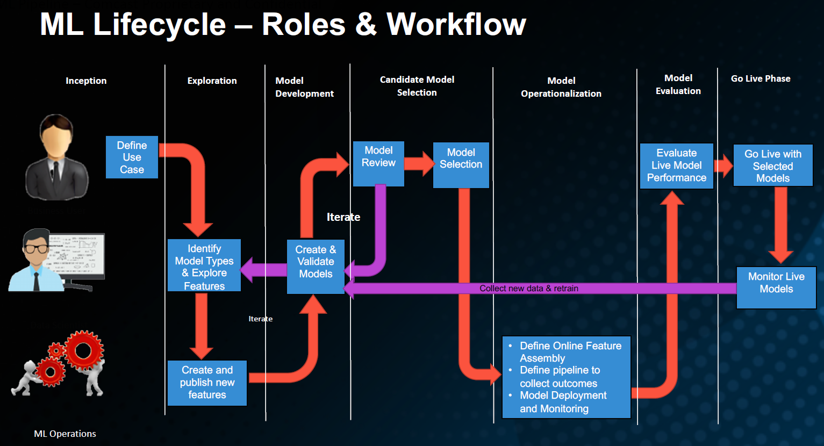
ML Workflow: actual customer example
Watson Studio
WML
OpenScale
IBM Cloud Pak for Data
Notes:
This ML Workflow can be implemented in IBM Data Science Platform (product names).

Slide 8
ML Workflow: actual customer example
Watson Studio
WML
OpenScale
IBM Cloud
Notes:
This ML Workflow can be implemented in IBM Data Science Platform (product names).

Slide 9
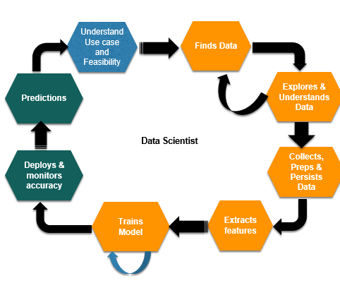
Model management
Monitor performance and accuracy
Predict model drift
Explain transactions
Monitor KPIs
Monitor fairness

Slide 10



Model management users
Line of business user
Data Scientist
DevOps

Slide 11
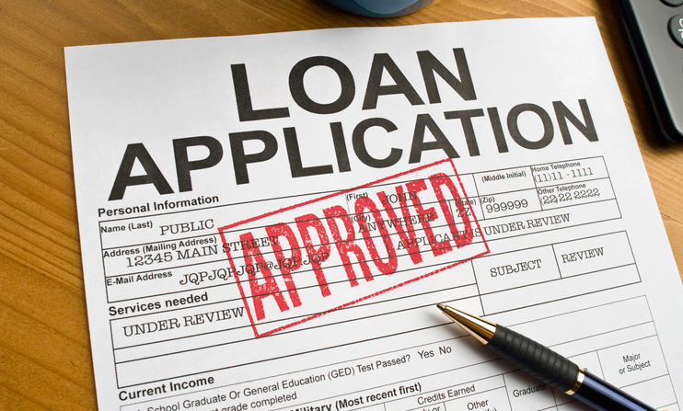
Demo
Demo: use case
A bank is monitoring a loan approval model
German credit risk dataset
Deployed classification model

Slide 12
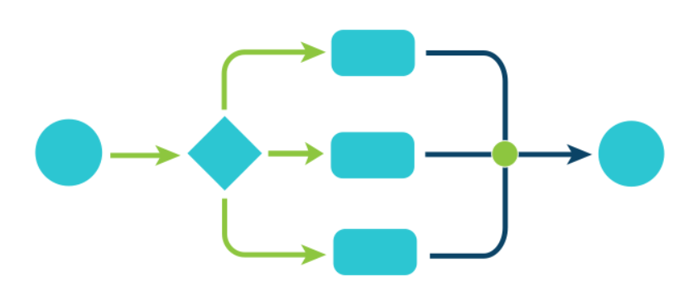
Demo
Demo flow
Capabilities overview
Architecture
Setup

Slide 13
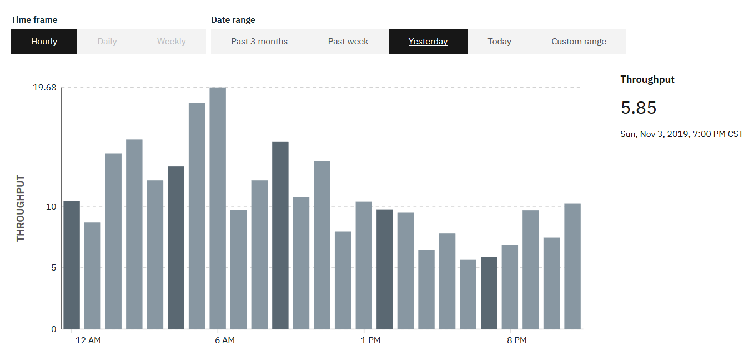
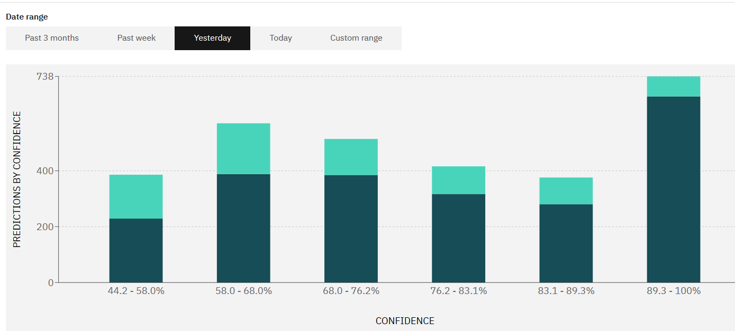
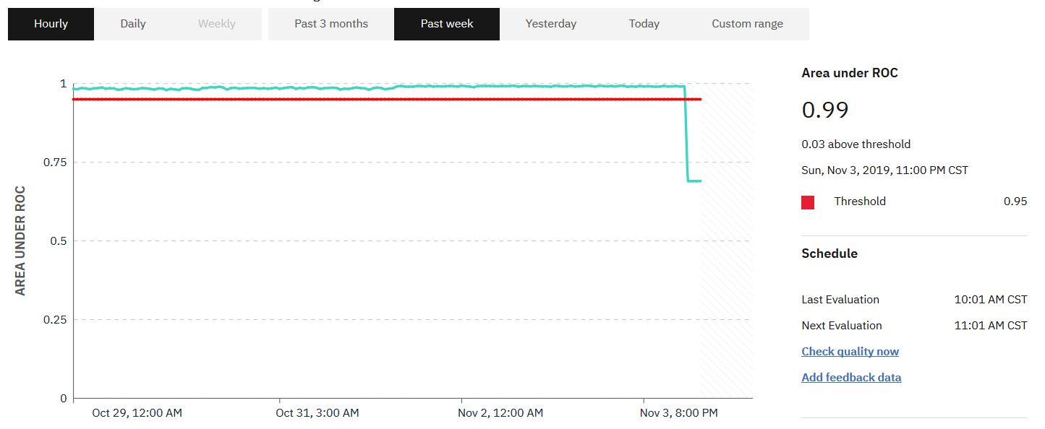
Model management
Monitor performance and accuracy
Predict model drift
Explain transactions
Monitor KPIs
Monitor fairness

Slide 14
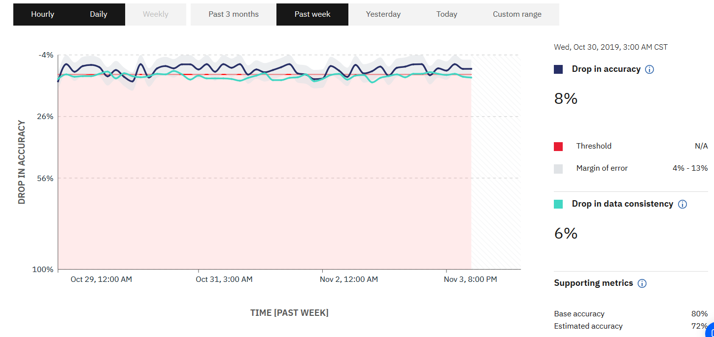
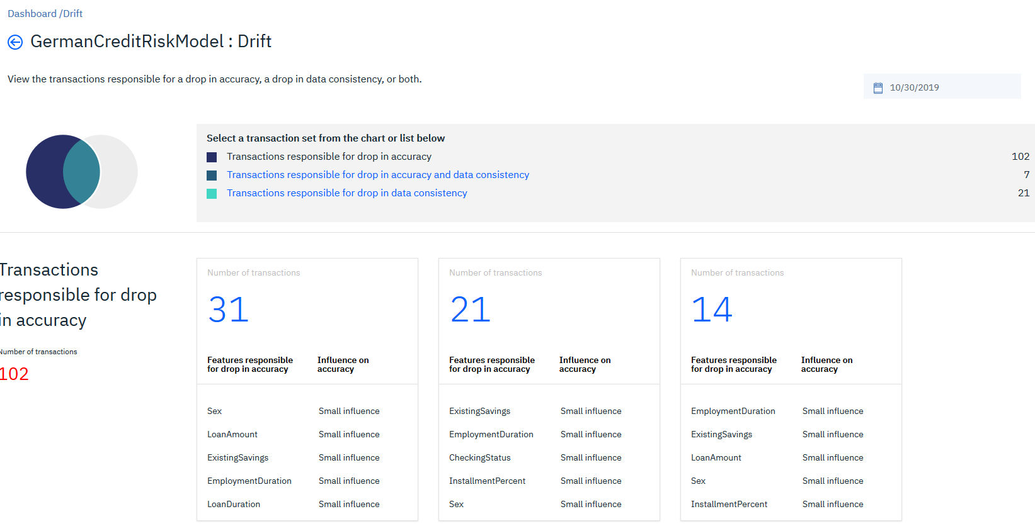
Model management
Monitor performance and accuracy
Predict model drift
Explain transactions
Monitor KPIs
Monitor fairness

Slide 15
How does it work model drift monitor work?
Prepare drift monitor:
Get model predictions for training data.
Generate an optimized drift-detection model using the training-data and their predictions.
Evaluate drift:
Identify the payload records which are likely correctly/incorrectly classified by model using drift-detection model.
Estimate the magnitude of model drift.
Customer Model
Payload-records
Training-data
Predictions of Training-data
Drift Detection
Model
Drift Detection
Model
Correctly Predicted
Payload-records
Incorrectly Predicted
Payload-records

Slide 16
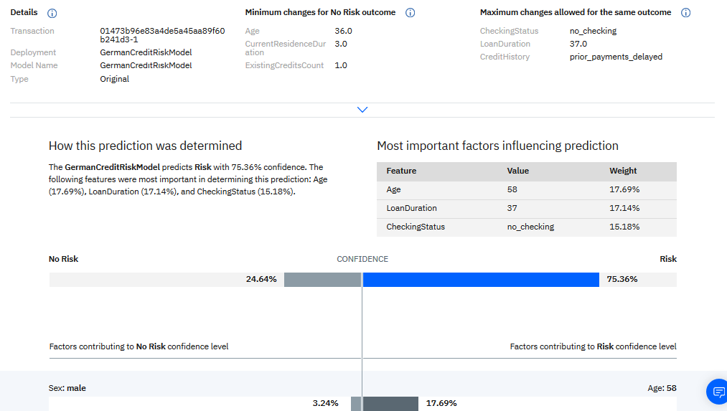
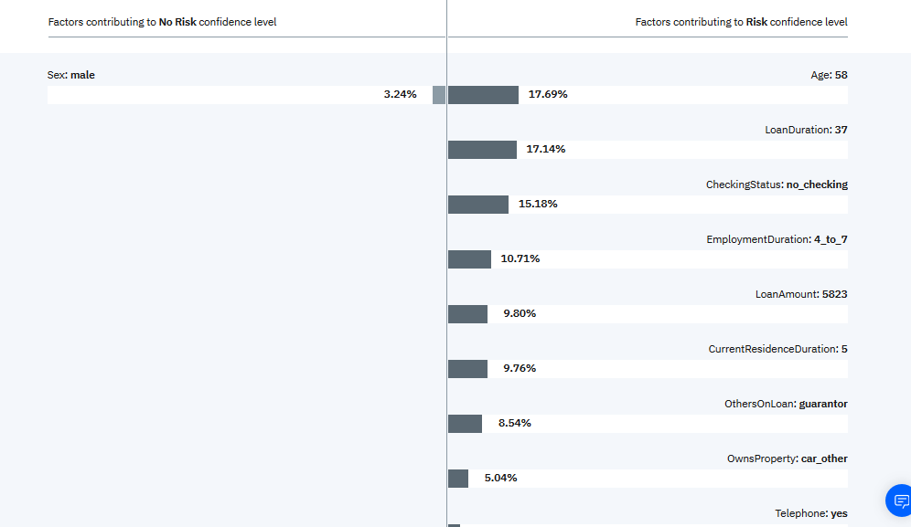
Model management
Monitor performance and accuracy
Predict model drift
Explain transactions
Monitor KPIs
Monitor fairness

Slide 17
How does Watson OpenScale explain a prediction?
1000’s of variations
applicant credit history
risk model
internal explanation models
perturbation
analysis
LOCAL EXPLANATION
CONTRASTIVE EXPLANATION
Notes:
Key takeaways
Calculated on an hourly basis (over a sliding window defined by the user)
Optimizations identify the right subset of data to perturb rather than perturbing all the data
Perturbed data is sent to the deployed model to determine effect of perturbations.

Slide 18
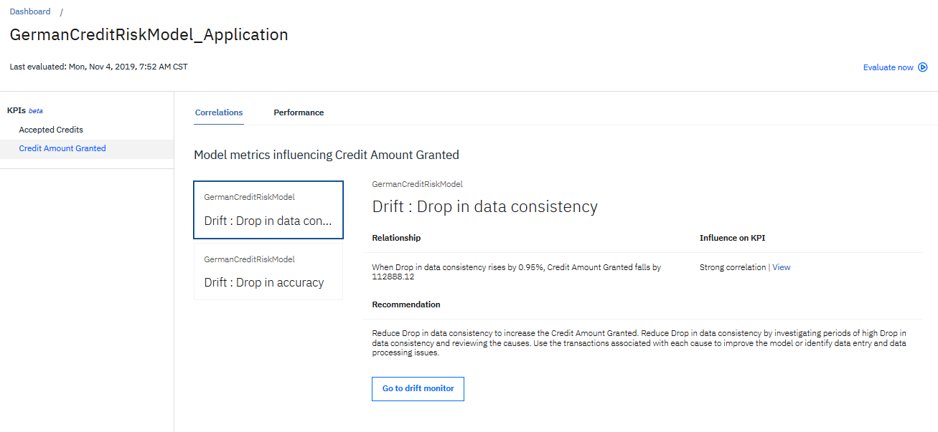
Model management
Monitor performance and accuracy
Predict model drift
Explain transactions
Monitor KPIs
Monitor fairness

Slide 19
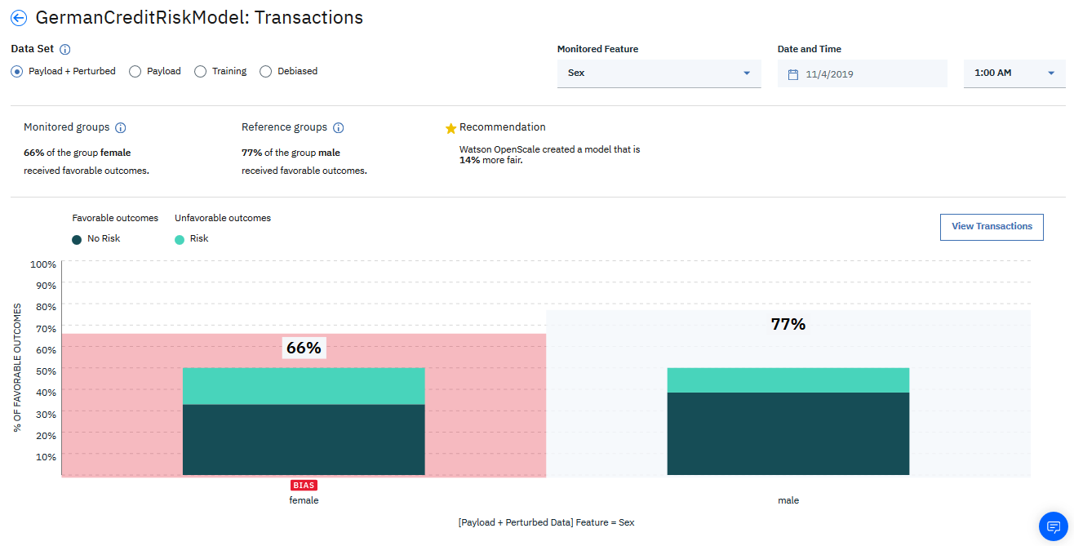
Model management
Monitor performance and accuracy
Predict model drift
Explain transactions
Monitor KPIs
Monitor fairness

Slide 20
How does Watson OpenScale flag and mitigate fairness issues?
variants over subset of data
applicant credit histories
risk model
internal bias detection model
perturbation
analysis
FAIR
UNFAIR
Calculated hourly over a sliding window
Notes:
Key takeaways
Calculated on an hourly basis (over a sliding window defined by the user)
Optimizations identify the right subset of data to perturb rather than perturbing all the data
Perturbed data is sent to the deployed model to determine effect of perturbations.
An internal bias detection model (logistic regression) is built using perturbed data that classifies whether new prediction will be biased or not.
Users receive both the original prediction plus the internal model’s classification of whether the monitored model’s prediction is biased or not. Passive and Active debiasing

Slide 21
Fairness monitor: details
Define protected fields: typically demographic information about a customer, such as race, age, gender, population segment (i.e immigrant, veteran, etc.).
Any field can be defined as “protected field”, it’s the field that you want to monitor for fairness
Define the context: number of records to use for determining the threshold
For example, evaluate every 100 approvals or every 1000 loan applications
Define a threshold for bias
Defined as a percentage of minority approvals (indicated by a protected variable) compared to approvals of majority.

Slide 22
Fairness monitor: details
For example, if we want to evaluate fairness for every 100 loan applications
Every time we get 100 new applications, the fairness check will automatically run
The fairness check will calculate the approval rate for the “majority group”
Let’s assume that we had 80 applicants from the majority group and 90%, or 72 applicants, of majority group were approved
OpenScale will then check against the threshold value that was specified
For example, if 70% was specified as the threshold value, than means that 70% percent of 90% (majority approval rate) must be achieved not to flag the bias
Let’s break it down more: 70% of 90% is 63%
We have 20 minority applicants, and that means that at least 13 applicants must be approved in order for the fairness flag not to be raised

Slide 23
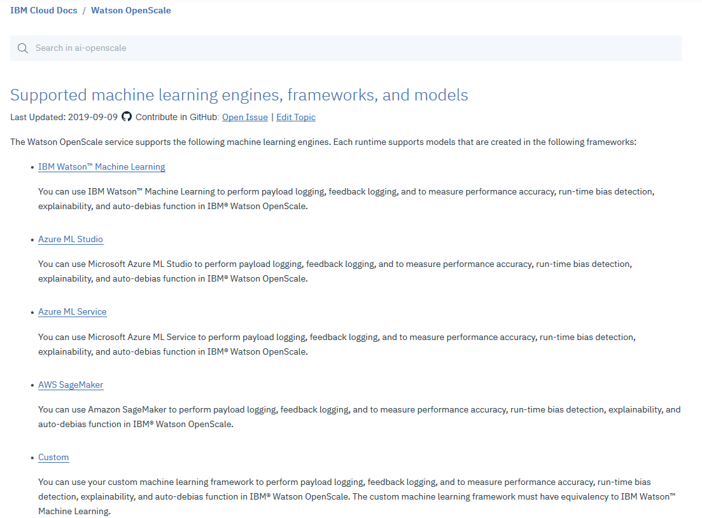
Watson OpenScale
Supported models
Architecture
Setup
Notes:
Supported frameworks: https://cloud.ibm.com/docs/services/ai-openscale?topic=ai-openscale-in-ov

Slide 24
Watson OpenScale
Supported models
Architecture
Setup

Slide 25
Architecture: Components
Client
Deployment server/service:
WML / AWS / Azure
Data to be scored
Payload
Watson OpenScale
Feedback
accuracy
bias
prediction rate
custom metrics
…
Derived Statistics
Data store
Notes:
Data store: DB2 or Postgres

Slide 26

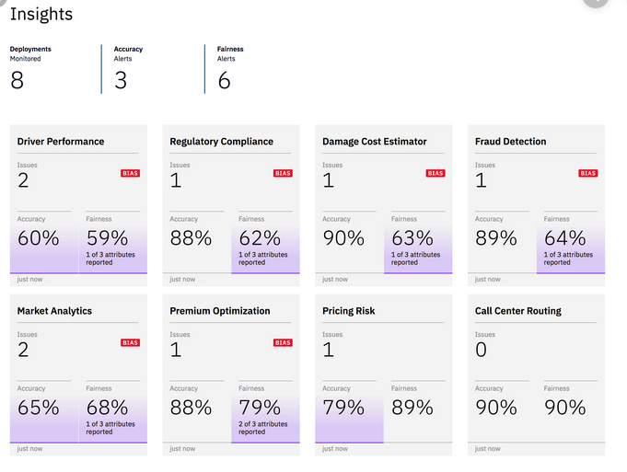

Architecture: on premise with WML as the deployment engine
Data to be scored
Browser: OpenScale UI
WML
Client
Watson OpenScale
Data store
Python SDK
IBM Cloud Pak for Data (CP4D)
Notes:
Python SDK documentation: https://cloud.ibm.com/docs/services/ai-openscale?topic=ai-openscale-crt-ov

Slide 27
Architecture: cloud with WML as the deployment engine
Data to be scored
Browser: OpenScale UI
WML
Client
Watson OpenScale
Data store
Python SDK
IBM Cloud
Notes:
Note: optionally, DB2 or Postres outside of CP4D can be used as a data store

Slide 28
Architecture: on premise with 3rd party deployment engine
Data to be scored
Browser: OpenScale UI
Watson OpenScale
Watson OpenScale
Client
Data store
Data store
Python SDK
3rd party scoring engine
IBM Cloud Pak for Data (CP4D)

Slide 29
Part 1: Walk through built-in OpenScale example in IBM Cloud
Part 2: Set up a custom OpenScale example in IBM Cloud
These labs can be completed later, written in self-study format
Hands-on Lab

Slide 30
Please give us your feedback – Access the survey link at the bottom of the
session details in the mobile app.
Session ID: J0688
Instructions: http://bit.ly/OpenScaleLab
Check-in Code: c836

